Slide 1


Bayesian Neural Networks for Uncertainty Estimation of Imaging Biomarkers
J. Senapati, A. Guha Roy, S. Pölsterl, D. Gutmann, S. Gatidis,
C. Schlett, A. Peters, F. Bamberg, C. Wachinger
Artificial Intelligence in Medical Imaging (AI-Med), KJP, LMU München, Germany
Department of Diagnostic and Interventional Rad., University of Tübingen, Germany
Department of Diagnostic and Interventional Rad., University Freiburg, Germany
Institute of Epidemiology, Helmholtz Zentrum München, Germany
ai-med.de
Notes:
Hello, I am Jyotirmay Senapati. Thank you for allowing me to present Bayesian Neural Networks for uncertainty estimation of imaging biomarkers on the MLMI workshop. In this paper, we wanted to use imaging biomarkers efficiently in post-analysis.

Slide 2
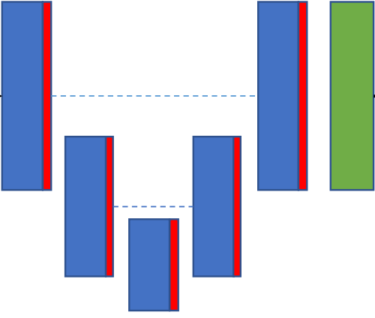


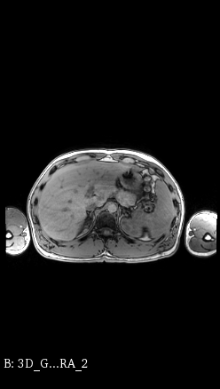
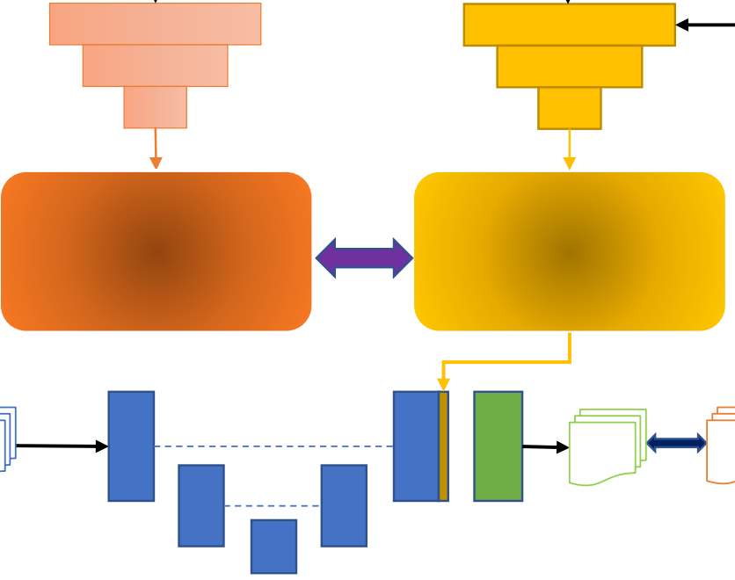

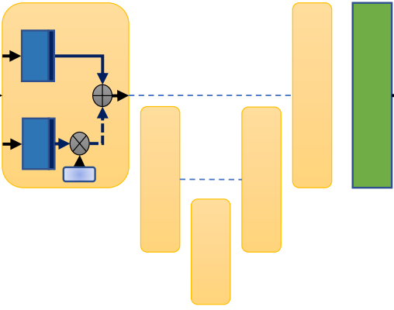
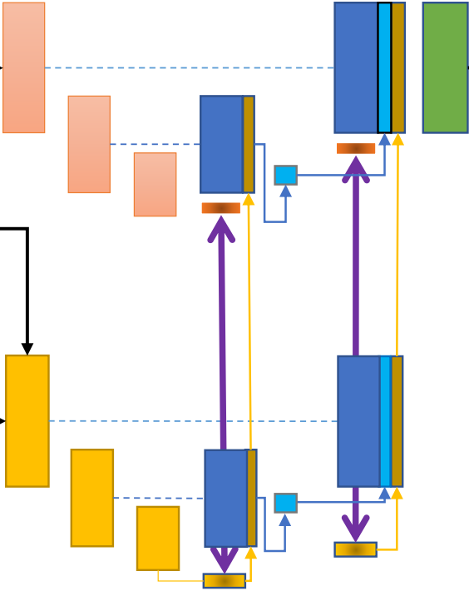
MOTIVATION
Introduction
GROUP ANALYSIS
DISEASE
CLASSIFICATION
WHAT IF THERE IS HUGE DATA!
...
DATA PRE-PROCESSING
SEGMENTATION
MANUAL QUALITY CONTROL
POST-ANALYSIS
Notes:
•The usual process is we have pre-processed data that we fed into segmentation models that produced automated segmentation outputs.
•Although DL has improved a lot in the last few years, yet the segmentation outputs are not perfect and they contain errors. Hence, we cannot use the automated segmentation in our post analysis directly. We need a quality control measure.
•It usually happens manually by a doctor who checks if a particular segmentation is good or bad and approves or rejects based on his knowledge. The segmentations, he approves goes to post-analysis.
•Now, in this process, we have 2 major demerits, 1: the manual QC is binary and depends on the doctor.
•2: What if there is huge data, it will be really difficult for a Quality controller or a group of the quality controller to analyze such huge data.

Slide 3
MOTIVATION
Introduction
GROUP ANALYSIS
DISEASE
CLASSIFICATION
...
DATA PRE-PROCESSING
SEGMENTATION
AUTOMATED QUALITY CONTROL
POST-ANALYSIS
Notes:
•Hence we wanted to test various QC measures we have on the different state of the art Bayesian models to test if the manual quality control can be automated and if that improves the quality of post-analysis.
•In the automated QC, the main aim is to regularise the effect of segmentation in post-analysis based on its confidence score. Hence good segmentations have more stake and bad segmentations have less stake in the post-analysis phase.

Slide 4
BAYESIAN MODELS
Segmentations
[1]
[2]
A
[3]
[4]
Notes:
So, To test we used 4 different state of the art Bayesian neural networks. These are MC Dropout, Fully Bayesian, Probabilistic U-net, and Hierarchical U-net. Bayesian neural networks are capable of generating multiple segmentations for a particular slice, which is needed to measure confidence score and …

Slide 5
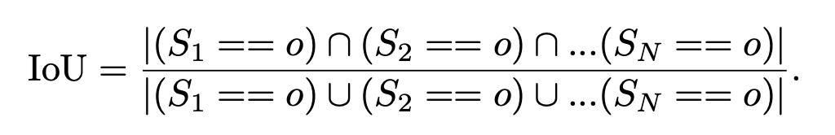
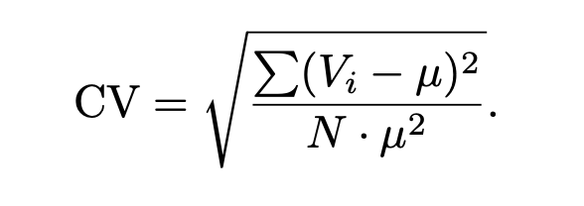
CONFIDENCE MEASURES
Quality Control
Intersection Over Union
[5]
Coefficient of Variation
[6]
[1, 5, 6] Roy, A.G., Conjeti, S., Navab, N., Wachinger, C. and Alzheimer's Disease Neuroimaging Initiative, 2019. Bayesian QuickNAT: Model uncertainty in deep whole-brain segmentation for structure-wise quality control. NeuroImage, 195, pp.11-22.
[2] Kingma, D.P., Salimans, T. and Welling, M., 2015. Variational dropout and the local reparameterization trick. In Advances in Neural Information Processing Systems (pp. 2575-2583).
[3] Kohl, S., Romera-Paredes, B., Meyer, C., De Fauw, J., Ledsam, J.R., Maier-Hein, K., Eslami, S.A., Rezende, D.J. and Ronneberger, O., 2018. A probabilistic u-net for segmentation of ambiguous images. In Advances in Neural information Processing Systems (pp. 6965-6975).
[4] Kohl, S.A., Romera-Paredes, B., Maier-Hein, K.H., Rezende, D.J., Eslami, S.M., Kohli, P., Zisserman, A. and Ronneberger, O., 2019. A Hierarchical Probabilistic U-Net for Modeling Multi-Scale Ambiguities. arXiv preprint arXiv:1905.13077.
Notes:
For that We used these two confidence measures that are intersection over union and coefficient of variation; in fact, we used the inverse of the coefficient of variation as that gives confidence score. The mean of samples generated from the Bayesian model became the final segmentation. We used 10 samples per slice for our experiment.

Slide 6
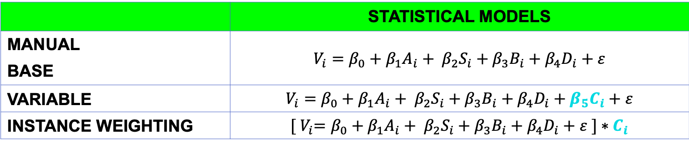
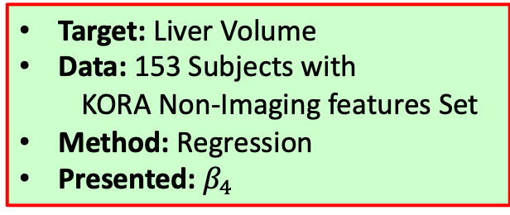
GROUP ANALYSIS
Post Analysis
 | STATISTICAL MODELS
MANUAL BASE | $$V_{i}=β_{0}+β_{1}A_{i}+ β_{2}S_{i}+β_{3}B_{i}+β_{4}D_{i}+ε$$
VARIABLE | $$V_{i}=β_{0}+β_{1}A_{i}+ β_{2}S_{i}+β_{3}B_{i}+β_{4}D_{i}+β_{5}C_{i}+ε$$
INSTANCE WEIGHTING | $${[ V}_{i}=β_{0}+β_{1}A_{i}+ β_{2}S_{i}+β_{3}B_{i}+β_{4}D_{i}+ε ]∗C_{i}$$
Target: Liver Volume
Data: 153 Subjects with
KORA Non-Imaging features Set
Method: Regression
Presented: $β_{4}$
AGE
BMI
SEX
MODEL ERROR
LIVER VOLUME
REGRESSION COEFFICIENT(S)
DIABETES STATUS
CONFIDENCE SCORE
Notes:
We have segmentation and confidence score, We want to use them differently in various post-analysis task, one of them is group analysis where we defined 4 methods named Manual, Base, Variable, and Instance Weighting.
We had Kora non-imaging features like age sex BMI and diabetes status as well.
The manual and base used the same statistical model whereas, in manual we use manual segmentations and in the base, we used automated segmentations. In Variable, we used confidence score as an extra variable and in Instance weighting, we used confidence score as an instance weight, which regulates how much the loss should affect the training of the model in the back-propagation phase.
for training We used 153 KORA Subjects with their non-imaging features, we used regression and root mean squared loss. We presented the regression co-efficient of diabetes status in the result.

Slide 7
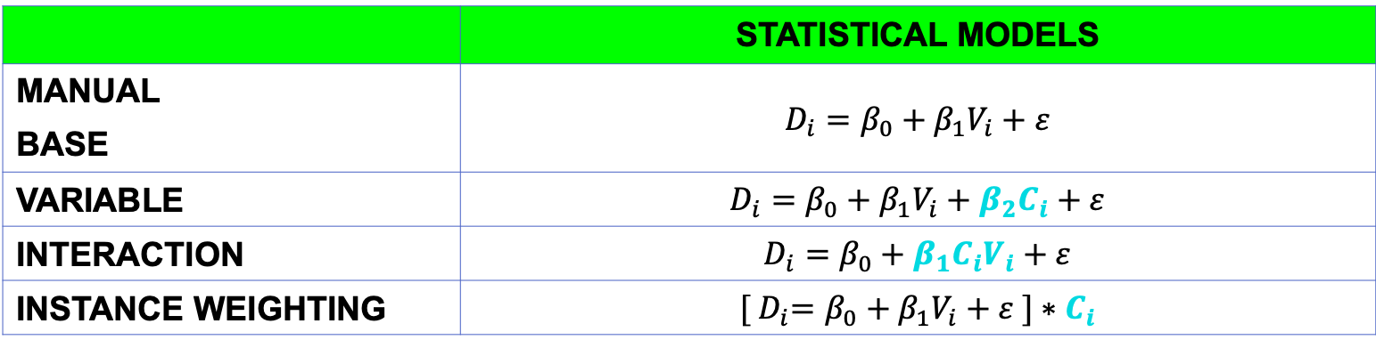
DISEASE CLASSIFICATION
Post Analysis
 | STATISTICAL MODELS
MANUAL BASE | $$D_{i}=β_{0}+β_{1}V_{i}+ε$$
VARIABLE | $$D_{i}=β_{0}+β_{1}V_{i}+β_{2}C_{i}+ε$$
INTERACTION | $$D_{i}=β_{0}+β_{1}C_{i}V_{i}+ε$$
INSTANCE WEIGHTING | $${[ D}_{i}=β_{0}+β_{1}V_{i}+ε ]∗C_{i}$$
Target Class: Diabetic, Non-Diabetic
Data:
Train: 77 Subjects, 27 Diabetic, 50 non-diabetic
Test: 76 Subjects, 26 Diabetic, 50 non-diabetic
Method: Logistic Regression
Process: Mean of 1000 randomly picked data trained model run
Presented: Classification Accuracy on test set
Notes:
Similarly, here we do disease classification for diabetes status, which is diabetic or non-diabetic. we used an extra statistical model that is interaction, where the confidence score interacts with the volume from automated segmentation.
We Used the Logistic regression for the statistical model training. we equally distributed class’s into train and test set 1000 times randomly and train the model on train set and evaluated on the test set. We presented a mean of 1000 test set classification accuracy scores.

Slide 8
EXPERIMENTAL RESULTS

Slide 9
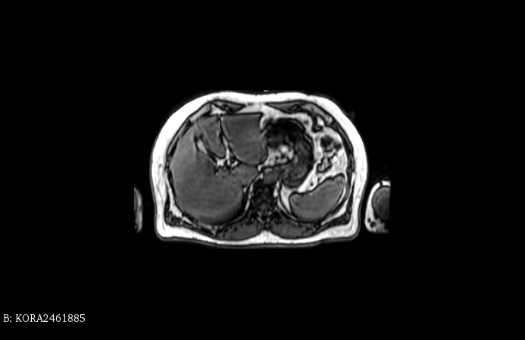
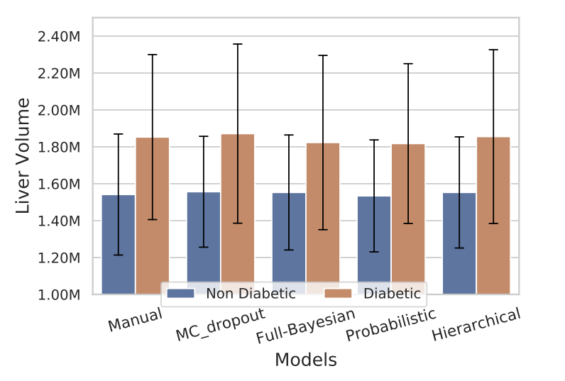
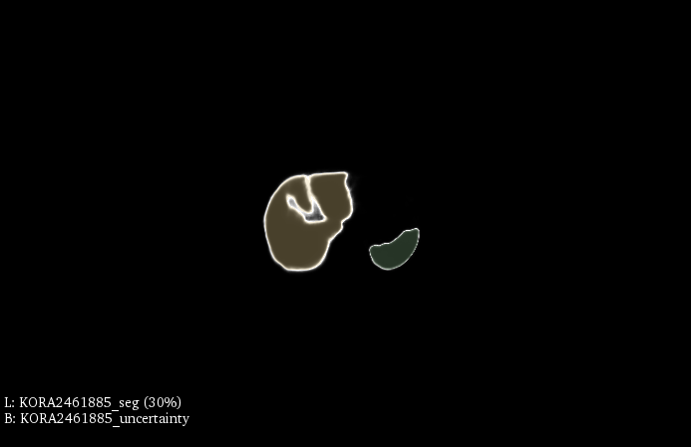
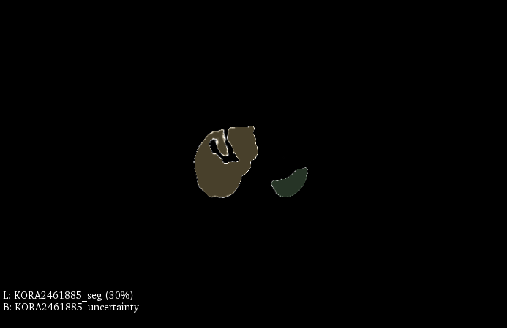
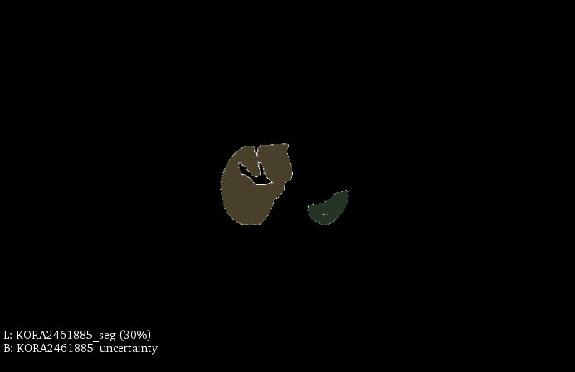

SEGMENTATION & UNCERTAINTY MAPS
MC Dropout
Probabilistic
Hierarchical
Full Bayesian
Notes:
For experiment we use liver as our target organ.
This graph shows the dice scores and variations in dice scores. The over all dice score is more than 90% which assures that Bayesian segmentation models has been well trained.
Here we can observe variations in segmentation results among the models we use. This shows various plausible segmentation results but not yet perfect and last we see there is a significant difference between liver volume for diabetic and non-diabetic patients which is why we presented dibetes reression coefficient while estimating liver volume in group analysis task to show correlation between them.

Slide 10
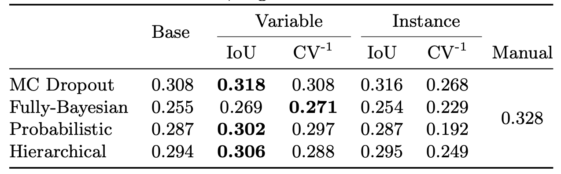
GROUP ANALYSIS
Refer Manual as higher limit, regression quality decreases with automated segmentation.
IoU as confidence measures improves the models when used as Variable.
MC Dropout works better among other models with IoU as Variable.
Notes:
In group analysis, where We have presented a regression co-efficient of diabetes status.
We found that the correlation of diabetes with the volume is higher in manual segmentation but decreases drastically with automated segmentation. That signifies that our automated segmentations are not as good as manual segmentations. Then we incorporate confidence scores in various ways to find out that Intersection Over Union as a variable improves the correlation and MC-Dropout as a Bayesian model works best among other models.

Slide 11
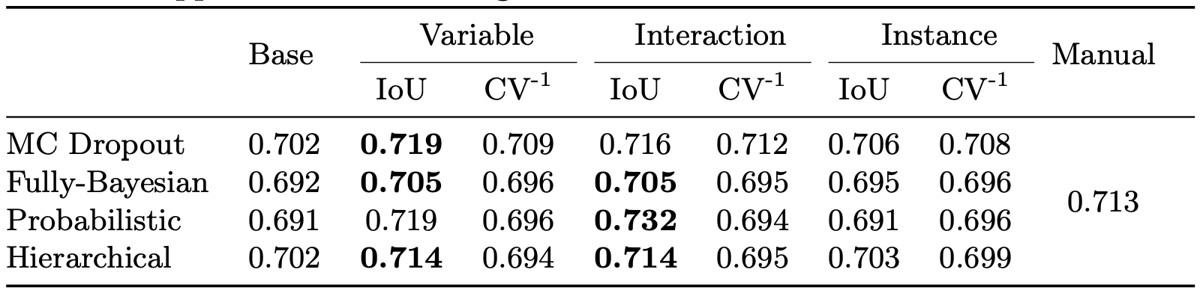
DISEASE CLASSIFICATION
Classification quality decreases with automated segmentation.
IoU as confidence measures improves the classifier when used as Variable or Interaction.
Probabilistic works better among other models with IoU as interaction.
Notes:
Similarly, In Disease classification, we found that IoU again as Variable and Interactive term improves the classification accuracy, and probabilistic U-Net works best among other bayesian models.

Slide 12
SEGMENTATION & UNCERTAINTY MAPS
Notes:
In another figure where the red contour shows the manual segmentation, the region in white shows automated segmentation from various models and their respective structural uncertainty map below. As you can see, mc dropout and full bayesian is highly uncertain compare to probabilistic and hierarchical as later models have been designed to find out the uncertainty among Intra rater whereas we have segmentations from a single rater only, hence less uncertainty. Or we can say later models are designed to capture aleatoric uncertainty and the former designed to capture epistemic uncertainty.

Slide 13
TAKEAWAYS
Confidence Inclusion Improves Post-Analysis.
Best Confidence Measure: Intersection Over Union (IoU).
Best Statistical Model: Variable & Interaction.
Best Bayesian Model: Monte-Carlo Dropout & Probabilistic U-Net.
Notes:
•At the end, we propose that the inclusion of confidence score improves post analysis results and quality. In our experiments, IOU is the best quality control compared to the coefficient of variations.
•Variation and Interaction way of including confidence scores improves the post-analysis quality better than other statistical models.
•MC dropout and Probabilistic u-net as the bayesian segmentation models work best in this analysis.

Slide 14

Thank You!
Check out our work at www.ai-med.de
Notes:
Thank you. Let us know if any questions.

Slide 15


DATA
PRE-PROCESSING
BAYESIAN
SEGMENTATION
AUTOMATED
QUALITY CONTROL
POST-ANALYSIS
MC DROPOUT
MANUAL
BASE
VARIABLE
INSTANCE WEIGHTING
FULLY BAYESIAN
GROUP ANALYSIS
$$IoU$$
DISEASE
CLASSIFICATION
STATISTICAL MODELS
PROBABILISTIC
$$CV^{−1}$$
...
MANUAL
BASE
VARIABLE
INTERACTION
INSTANCE WEIGHTING
HIERARCHICAL

